Slide 1
AWS Storage
Types of storage :-
Simple Storage Service (S3) – To store unstructured data
Elastic File System (EFS) – For Linux based system only
Elastic Block Storage (EBS) – Storage for EC-2 machine
Glacier – Store data for very long time
Snowball – Portable storage that is used to migrate very huge amount of data from datacentre to cloud.
Note :- Now Glacier is part of S3 & so both are together is known as Glacier S3.

Slide 2
Difference between Block level storage & Object level storage
Block Level Storage 1.It is suitable for transactional, database,random read/write loads & structured database storage. 2.Data is divided into equal sized blocks(data chunk) for instance before it is stored. 3. Data blocks stored on storage do not contain metadata. 4. Block storage only keeps the address(index) where the data blocks are stored. | Object Level Storage 1.It store whole data without dividing into data blocks. 2.An Object can be – - The File or Data itself - Its metadata - Object Global Unique ID 3.The Object Global Unique ID is a unique identifier for the object. 4.Object storage can not be mounted as drive. Ex. Dropbox, Facebook, AWS S3 etc.

Slide 3
S3 & S3 Bucket Naming Rules
S3 1. It is a storage for internet. 2. It is object based storage. 3. You can not install OS on S3. 4. It has distributed data store architecture where objects are randomly stored on multiple locations.(Max. 3 location in same region) 5. Data is stored in Bucket. 6. Max. capacity of bucket is 5 TB. 7. You can create folders in your bucket 8. You can not create nested bucket. 9. Bucket ownership is non-transferable. 10. S3 bucket is region specific. 11. You can have upto 100 buckets per account (may expand on request) | S3 Bucket Naming Rules Bucket name is globally unique. It can not be changed after creation. If bucket id deleted, its name can be used by another aws account. Bucket name must be between 3 to 63 characters. Bucket name is the part of URL used to access a bucket. Bucket name contain lowercase,numbers,dot and hyphen.(can not be uppercase). Bucket name should not be an IP address. Each label must start and end with a lowercase letter or a number. By default bucket and its object is private & only owner can access the bucket.

Slide 4
S3 Bucket – Sub-resources
It include :-
Lifecycle – To decide lifecycle management for objects
Websites – To hold configurations related to static website hosted in S3 bucket
Versioning – Keep object version as it change or get updated
- Can not be disabled when you enable it (only suspended)
4. Access Control List – Bucket policies
----------------------------------------------------------------------------------------------------
Bucket Name has two parts :–
a. Bucket region endpoint b. bucket name
Ex. For S3 bucket named mybucket in Mumbai Region
https://mybucket.s3.ap-south-1.amazonaws.com/aws.png

Slide 5
S3 Object
An object size stored in an S3 bucket can be 0 byte to 5 TB
Each object is stored and retrieved by a unique key (ID or Name)
An object in S3 is uniquely identified through :
! Service Endpoint
! Bucket Name
! Object Key (Name)
! Optionally Object Version
Object stored in S3 bucket never leave its region unless you move to another region
A bucket owner can grant cross-account permission to another AWS account user in another account or to upload objects
You can grant S3 bucket/object permission to :
! Individual User
! AWS Account
! Make the resource public
! To all authenticated users

Slide 6
Lab 1 :- How to create bucket graphically
Lab 2 :- How to create bucket using CLI (install AWS CLI)
STEP :-
Go to CMD and type AWS configure
Generate Access Key ID – Go to AWS management console
- Click on account name and select My security Credential
- Select continue to security Credential from pop-up menu
- Select Access key & select create new access key
- Download Key File & open it
Enter Access Key ID & Secret Access Key [aws s3 ls]
Now make bucket : (c:\>aws s3 mb s3://pawanxpress)
Remove bucket : (c:\>aws s3 rb s3://pawanxpress)
Synch a folder from PC(desktop folder named aws1) to bucket : c:/>cd desktop cd aws(folder name)
: c:\>aws s3 sync . s3://pawanxpress
- Sync from bucket to PC if file deleted from that folder : c:\>aws s3 sync s3://pawanxpress .

Slide 7
Install aws cli on Linux :
curl "https://awscli.amazonaws.com/awscli-exe-linux-x86_64.zip" -o “awscliv2.zip”
unzip awscliv2.zip (run -----dnf install unzip-------if command not found)
./aws/install
aws --version----- ( ln –s /usr/local/bin/aws /usr/bin ----for root user if command not found)
------------------------------------------------------------------------------------------------------------------------------------------------
Lab 3 : S3 Versioning
Bucket versioning is a S3 bucket sub resource that is used to protect against accidental data deletion.
Once you enable versioning on a bucket, it can’t be disabled, only suspended.
When you delete an object, a delete marker is placed on the object.
You are charged for all object version stored in S3.
You can use versioning with S3 lifecycle policies to delete older version or to move them into a cheaper S3 storage.
Object existing before enabling versioning have version id “NULL”.
All existing objects & their versions remain same when you suspend versioning.
An object deletion in a suspended versioning bucket, delete only the object with id “NULL”.
Lab 4 :- Cross Region Replication (CRR) <Note: Versioning must be enabled for CRR>

Slide 8
Types of AWS S3 storage :-
Amazon S3 Standard
Amazon S3 Standard IA
Amazon S3 Intelligent Tiering
Amazon S3 One Zone IA
Amazon Glacier
Amazon S3 Glacier Deep Archive

Slide 9
1. Amazon S3 – Standard
- Used for frequently accessed data
- Durability is 99.999999999 %
- Designed for 99.99 % availability in a given year.
- Support SSL for data in-transit & encryption of data at rest.
- Storage cost for the objet is fairly high but very less charge for accessing
- Largest object that can be uploaded in a single PUT is 5 GB.
2. Amazon S3 Standard -IA (Infrequent Access)
- Used for less frequently accessed data but require instant access when needed
- Durability is 99.999999999 %
- Storage cost for the objet is less but very more charge for accessing
- 99.9 % availability in a given year.
- Support SSL for data in-transit & encryption of data at rest.

Slide 10
3. Amazon S3 Intelligent Tiering
- Designed to optimize automatically by moving data to the most cost effective access-tier
- Durability is 99.999999999 %
- 99.9 % availability in a given year.
- It work by storing object into two access-tier
- If an object in IA is accessed, it is automatically moved back to frequent access-tier
- There is no rental fee for moving object between different access-tier
- Object less than 128 KB can not be moved to IA
4. Amazon S3 One Zone IA
- Used for less frequently accessed data but require instant access when needed
- Ideal for those who want lower cost option of IA data
- Data stored in a single AZ, so data is lost in the event of AZ destruction
- Durability is 99.999999999 %
- 99.5 % availability in a given year.
- Good choice for storing secondary backup of on premises data or easily re-creatable data

Slide 11
5.Amazon S3 Glacier
- It is a secure,durable & low cost storage class for data archiving
- It provide three retrieval option from a few minute to hours.
- Durability is 99.999999999 %
- 99.99 % availability in a given year.
- You can upload object directly to Glacier or use Lifecycle policies
- Support SSL for data in-transit & encryption of data at rest.
- You can retrieve 10 GB data per month from Glacier with free tier account
6.Amazon S3 Glacier Deep Archive
- Cheapest storage option
- Design to retain data for long period
- Objects are stored across at least three AZ
- Durability is 99.999999999 %
- 99.99 % availability in a given year.
- Ideal for magnetic tape libraries
- Retrieval time within 12 hrs

Slide 12
How to connect S3 with local machine ?
Create one bucket in each Mumbai Region & Singapore Region.
Create replication between Mumbai & Singapore bidirectionally.
Download TNT drive for S3 from google & Install it.
Open TNT, Mount Bucket, Add some file & Check on Cloud.

Slide 13
EFS (Elastic File System)
It provides simple & scalable elastic file storage for use with AWS cloud services and on-premises resources.
It is easy to use and offers a simple interface that allows to create and configure file system quickly.
Unlimited storage, size grow or shrink automatically as we add or remove files
As a regional service, EFS store data across multiple AZ for high availability and redundancy.
It can be mounted to N no. of Instances.
Amazon EC2 instance & on-premises server both can access EFS file system at same time.
This service is not available in all region.
You pay for what you use, with no commitments and up-front fees.
Price - $0.30/GB per month & 5 GB under free tier account.

Slide 14
Lab : EFS with Linux EC2 Instance
Go to VPC, Create a Security Group (EFS-SG), Add SSH & NFS in Inbound Rule
Go to EFS, Create EFS (MYEFS)
Now launch two Linux EC2
Access 1st EC2 & run the following command
# yum -y update
# yum -y install nfs-utils
# mkdir efs
Now go to efs, Click on the name, Attach, select via IP, Copy link and paste on EC2
#cd efs
#touch file1 & #ls
Now access 2nd EC2 & repeat above task

Slide 15
EBS(Elastic Block Storage)
There are two types of block storage option available for EC2 instances :-
1. Elastic Block Storage (EBS backed EC2 Instance)
- Persistent storage – Data is not deleted if EC2 stopped/rebooted
- Network attached virtual drive
2. Instance store backed EC2
- Virtual hard drive on the host allocated to EC2 instances
- Limited to 10 GB storage per device
- Non-persistent storage
- Data will be deleted if EC2 instance is stopped or terminated but not in case of reboot

Slide 16
Types of EBS volume
1. SSD Backed Volume
- It is of two type
a.) General Purpose SSD (GP2) b.) Provisioned IOPS SSD (io1)
2. HDD Backed Volume
- It is of two type
a.) Throughput Optimized HDD (st1) b.) Cold HDD (sc1)
3. Magnetic Standard

Slide 17
1. SSD Backed Volume
General Purpose SSD (GP2) 1. It is default EBS volume type. 2. GP2 volumes are backed by SSD. 3. Ratio of 3 IOPS/GB with upto 10000 IOPS. 4. Volume Size = 1 GB to 16 TB 5. Price = $0.10/month 6. Can be used as Boot Volume. | Provisioned IOPS SSD (io1) Ideal for both IOPS & throughput intensive workloads that require extremely low latency. Use if you need more than 10000 IOPS. Can provision upto 32000 IOPS per volume. Volume Size = 4 GB to 16 TB Price = $0.125/GB/month Can be used as Boot Volume.

Slide 18
2. HDD Backed Volume
Throughput Optimized HDD (st1) Ideal for frequently accessed ,throughput intensive workloads with large datasets. Performance is measured in MB/s. Can not be used as Boot Volume. Can provision upto 500 IOPS per volume. Volume Size = 500 GB to 16 TB Price = $0.045/GB/month | Cold HDD (sc1) Provide the lowest cost per GB in comparison to all available EBS volume types. Used in file servers. Can not be used as Boot Volume. Can provision upto 250 IOPS per volume. Volume Size = 500 GB to 16 TB Price = $0.025/GB/month

Slide 19
3. Magnetic Standard (Previously it was known as EBS Standard)
Have lowest cost per GB among all EBS volume type that is bootable.
Ideal for workloads where data is accessed infrequently.
Price = $0.05/GB/month
Volume Size = 1 GB to 1 TB
Max. IOPS/volume = 40 to 200

Slide 20
EBS Snapshot
EBS snapshots are point-in-time image or copy of EBS volume.
Any data written into the volume after snapshot process initiation, will not be included.
It is just like an incremental backup, the first snapshot that is taken of a volume will contain a full copy of the volume.
5000 EBS volume can be created per AWS account.
10000 EBS snapshot can be created per AWS account.
EBS snapshots are stored in S3 but can’t be accessed directly.
EBS volumes are AZ specific while snapshots are region specific.
Any AZ in region can use snapshot to create EBS volume.
To migrate EBS from one AZ to another, create a snapshot and then create an EBS volume from that snapshot in intended AZ.
To take complete snapshot of non-root volume, stop or unmount the volume
To take complete snapshot of root volume, stop the instance.

Slide 21
Snowball & Snowmobile
AWS Import/Export Disk was used to move large amount of data from on-premises to AWS Cloud & it was difficult for AWS to manage.
Now a days Snowball & Snowmobile is used to transfer large amount of data using physical storage appliances.

Slide 22
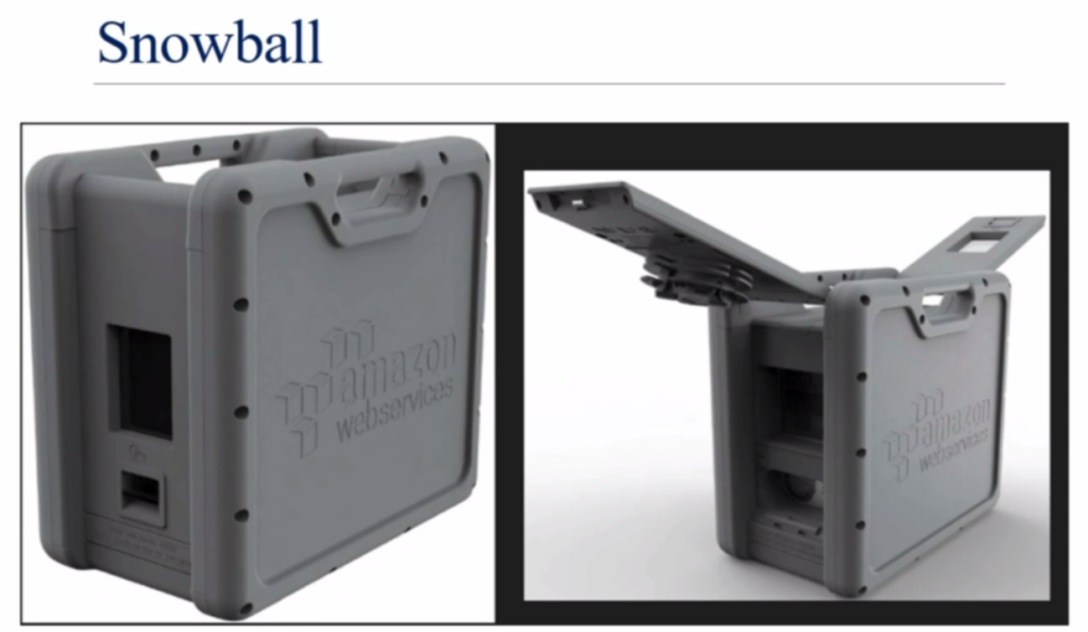

Slide 23
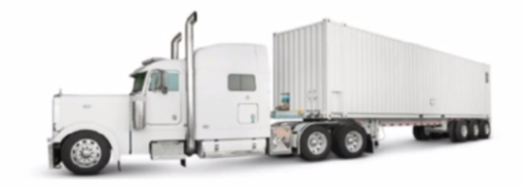
Snowmobile
- It is an Exabyte-scale data transfer service used to move extremely large amount of data.
- You can transfer 100PB per snowmobile.
- Transferring data with snowmobile is secure, fast and cost-effective.

Slide 24
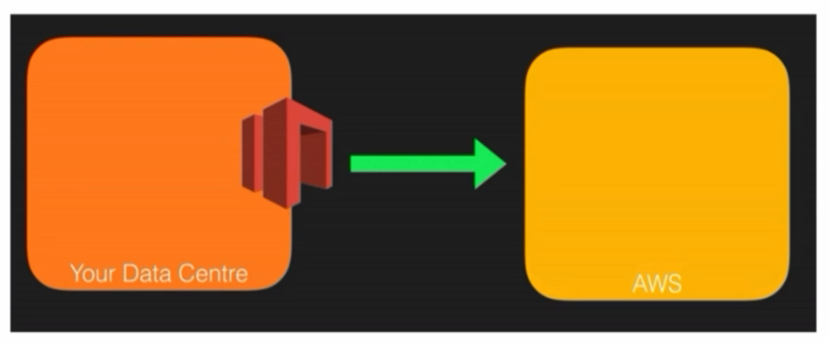
Storage Gateway
It is used transfer data directly from on-premises to AWS cloud storage.
AWS Storage Gateway’s software appliance is downloaded as VM image & installed on a host in datacentre.
Then it is integrated with AWS.
It support either VMware ESXi or Microsoft Hyper-V

